Slide 1
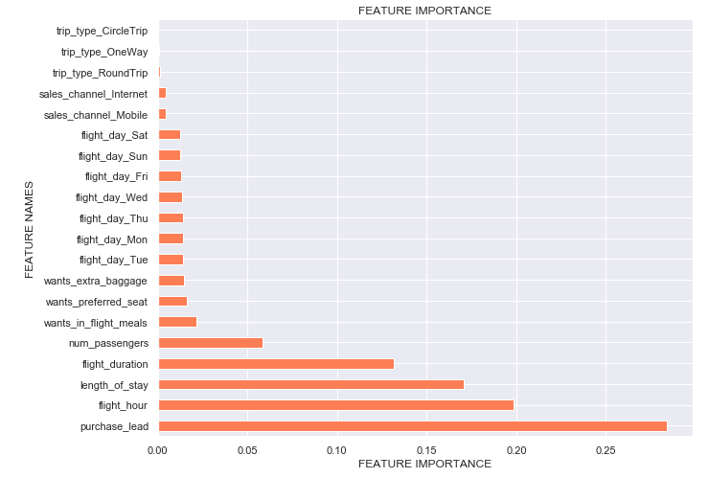
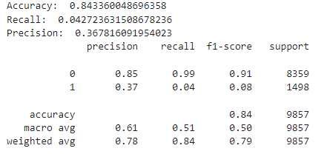
PREDICTING CUSTOMER BUYING BEHAVIOUR
Results from Random Forest Classifier
Anisah Bacchus
January 2023

